Slide 1
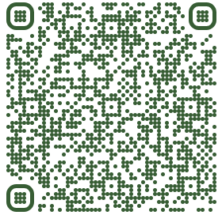
Details at:
https://www.nationaldentalpbrn.org/blog/the-implant-registry-study-is-recruiting-dentists-who-restore-implants/
Find out more:

