Slide 1
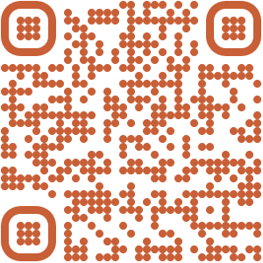
Details at:
https://www.nationaldentalpbrn.org/blog/paas/
Find out more:

Slide 2
Participation in the periodontal adjunctive antibiotics study (PAAS)
WHICH PATIENTS CAN PARTICIPATE?
Are 40 years old or older.
Are being treated for periodontal disease stage II-III, grades A-C (previously generalized moderate- to-severe periodontitis).
Have not used systemic antibiotics in the previous 3 months.
Have not had periodontal therapy (including SPR D4341, D4342) in the previous 6 months.
WHY SHOULD YOU PARTICIPATE?
Advance the science and practice of periodontology
Participating dentists or hygienists will receive a total of $250 remuneration per participant:
$100 baseline, $100 re-evaluation and $50 at the final visit
$4,000 upon enrolling the target sample size of N=16 participants
$5,500 if enroll the maximum of 22 participants
Patients will be compensated $50 per study visit

